Slide 1
A Project Presentation on
Easy-PG
SUBMITED BY
Abhishek Magdum(233122)
Rohan Sarode(233193)

Slide 2
INDEX
Introduction
Objectives
UML Diagrams
Functional Requirments
Screenshots
Specification
S/W and H/W Requirement
Future Scope
Conclusion

Slide 3
Introduction
A PG Management System is a digital solution designed to simplify and streamline the administration and management of paying guest accommodations. These accommodations are often used by students, working professionals, and others who need temporary lodging in a city or region

Slide 4
This is initiative to create an online platform for customers to rent/buy properties at best and competitive price and will act as a broker between customer and owner with zero brokerage fees.
This platform will reduce the hassle of people looking for properties, So Easy-PG provides one stop solution for such problem.
Easy-PG provides simple yet effective platform for property dealing.

Slide 5
Technologies used
Front End – React
Back End – Java Spring Boot
Database – MySql

Slide 6
UML Diagrams

Slide 7
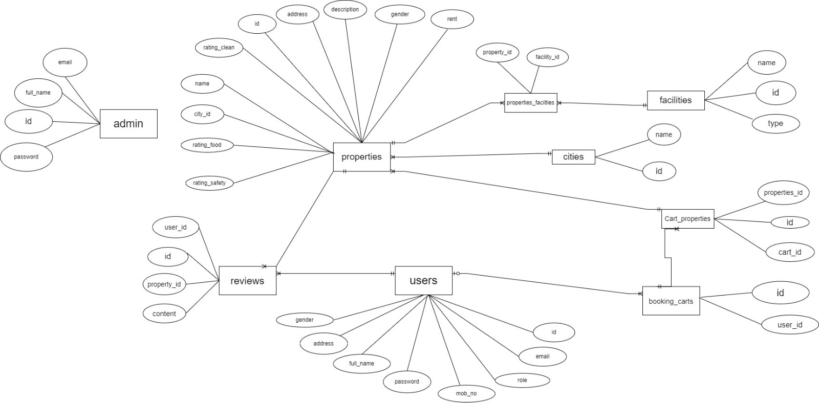
ER Digram

Slide 8
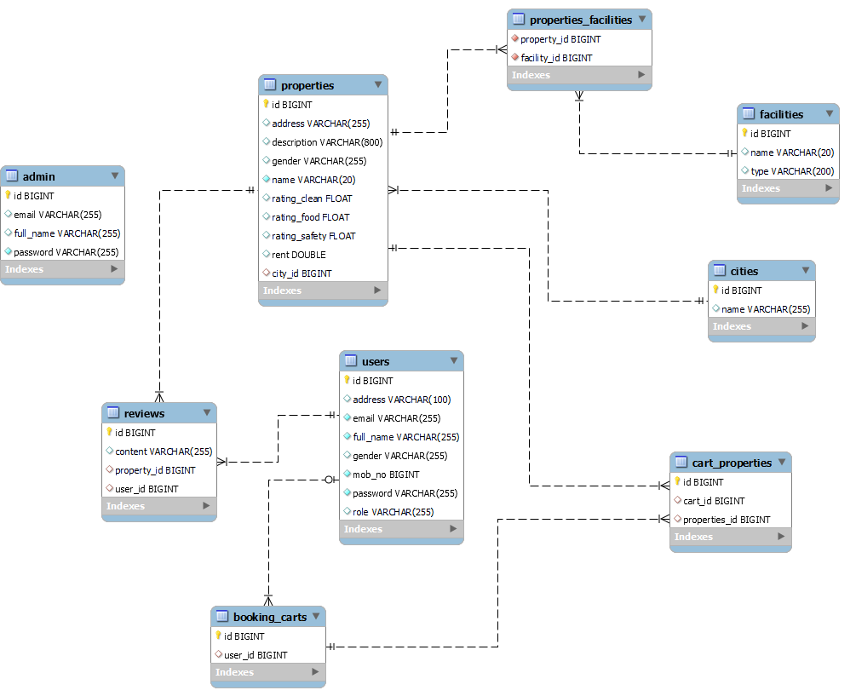
Class Digram

Slide 9
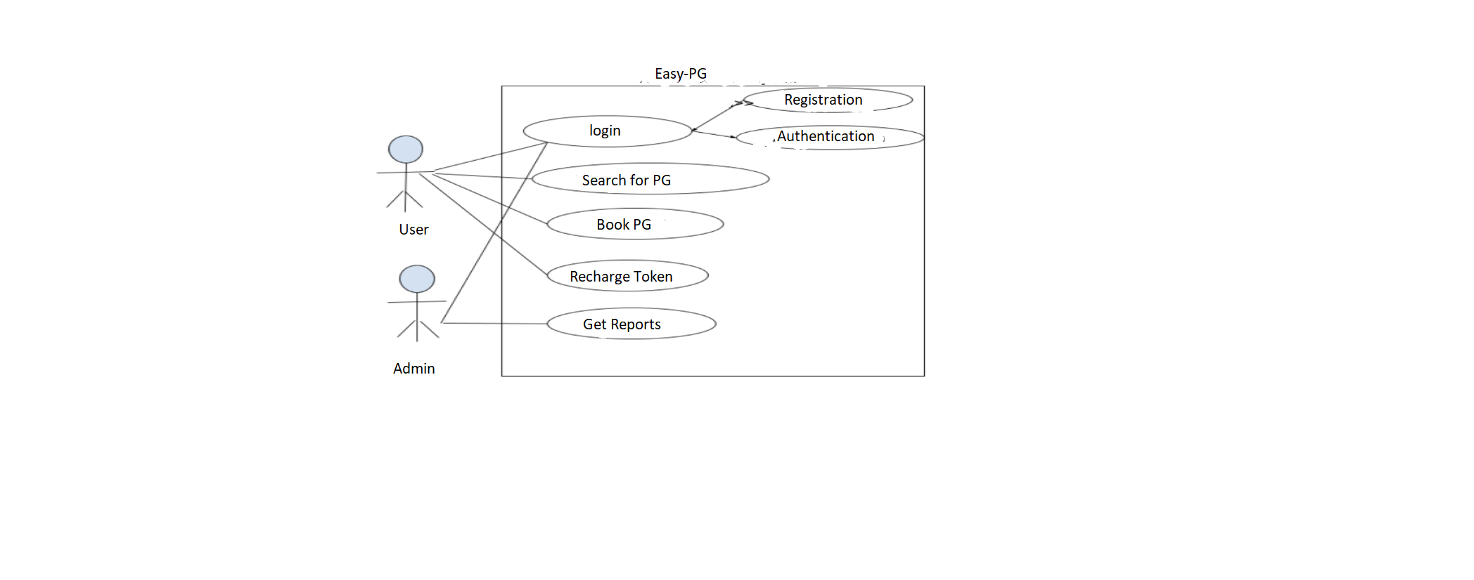
Use Case Digram

Slide 10
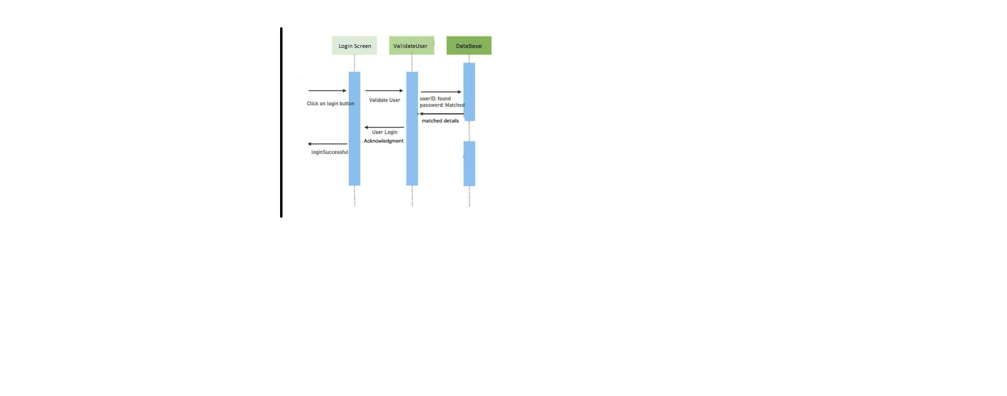
Sequence diagrams

Slide 11

Activity Digram For Authentication /Login

Slide 12
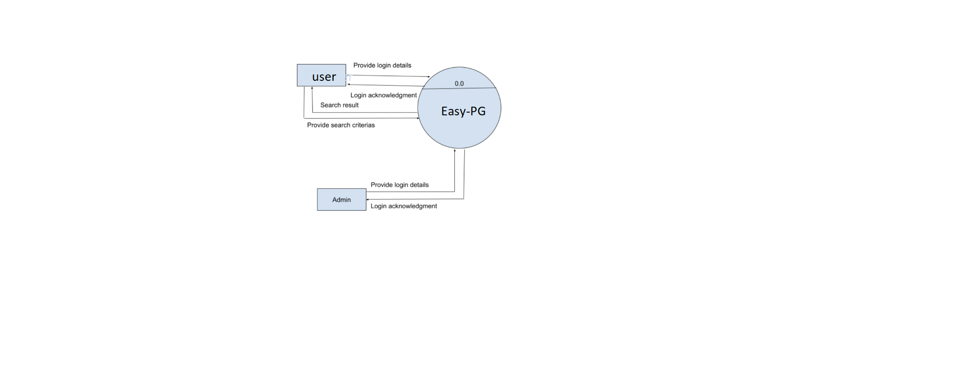
0th Level DFD Digram

Slide 13
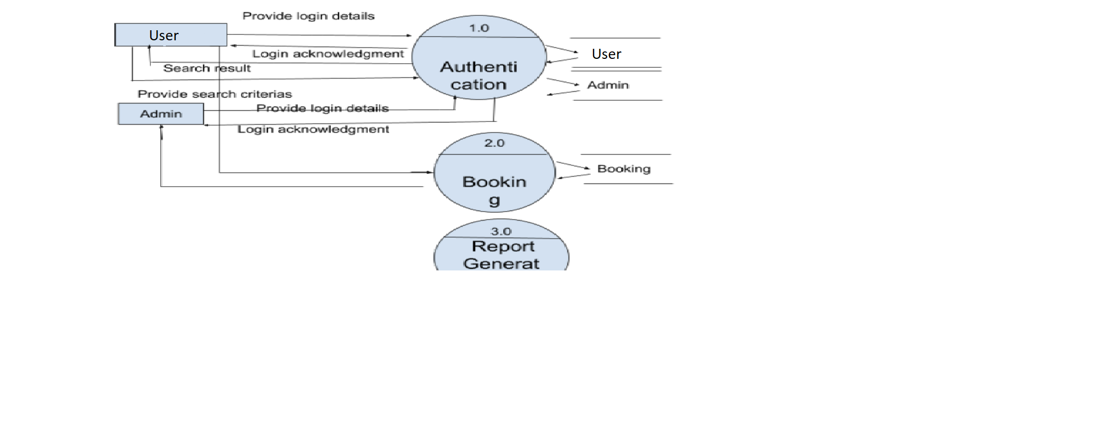
First Level DFD Digram

Slide 14
Functional Requirement
1. Tenants:-
The user must register for create the account and login using username and password to use function in the application
The user can find the information of home which should he/she take on rent.
The user can directly contact with owner after he/she interested to take home on rent.

Slide 15
2. Owner:-
The owner must register for create the account and login using username and password to use function in the application.The user can add home details which he/she will gives on rent.
3. Admin:-
-The Admin has authority to give access to owner for add details of home to give on rent after owner’s login.

Slide 16
ScreenShots

Slide 17
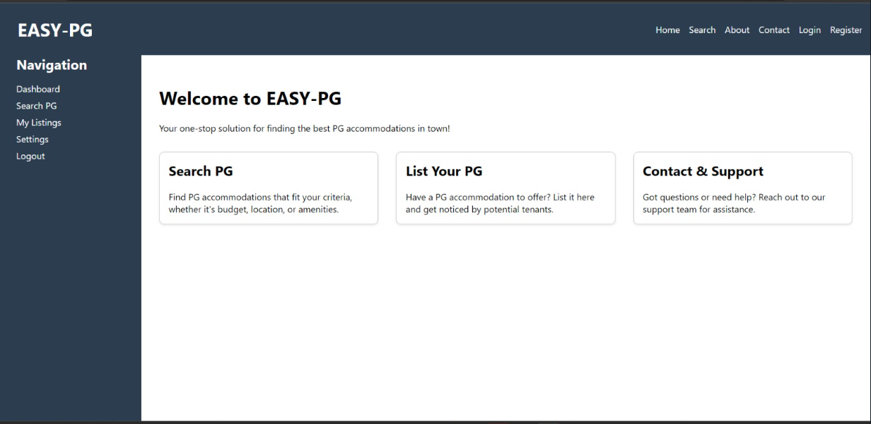

Slide 18
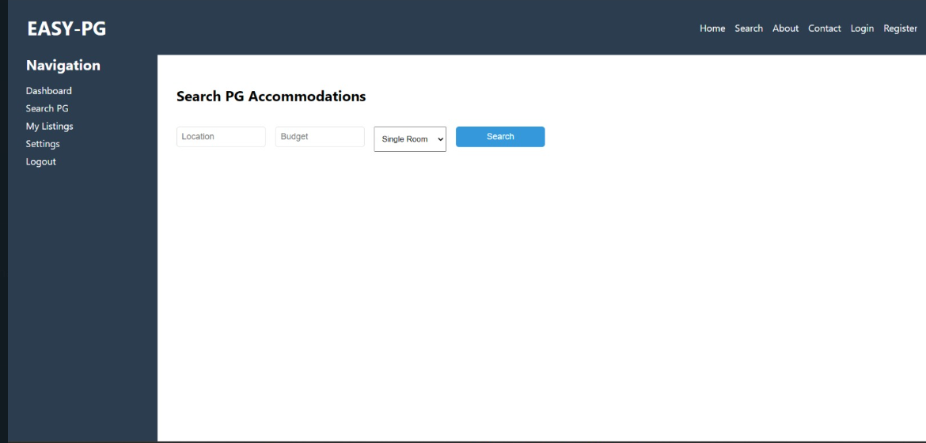

Slide 19
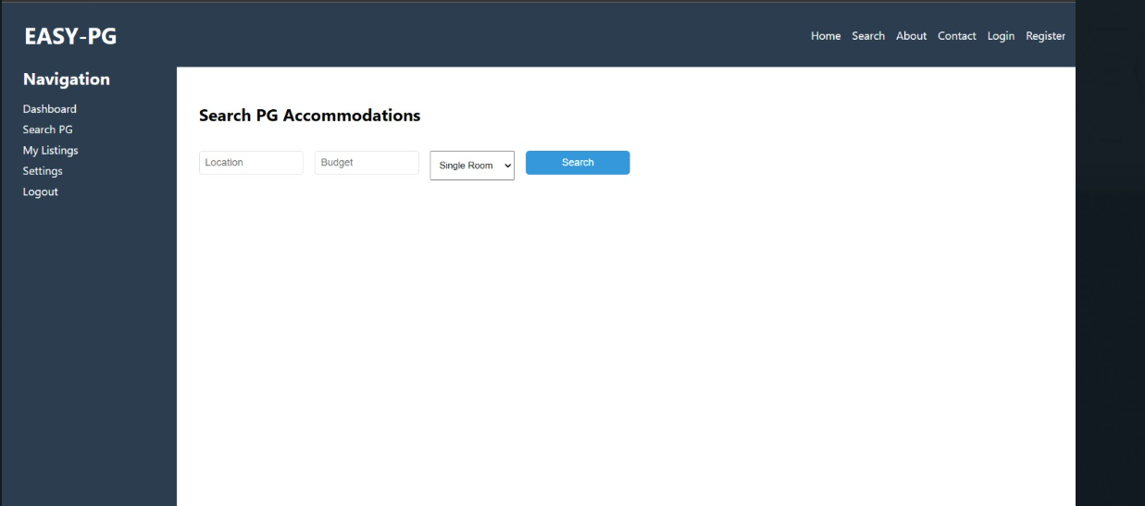

Slide 20
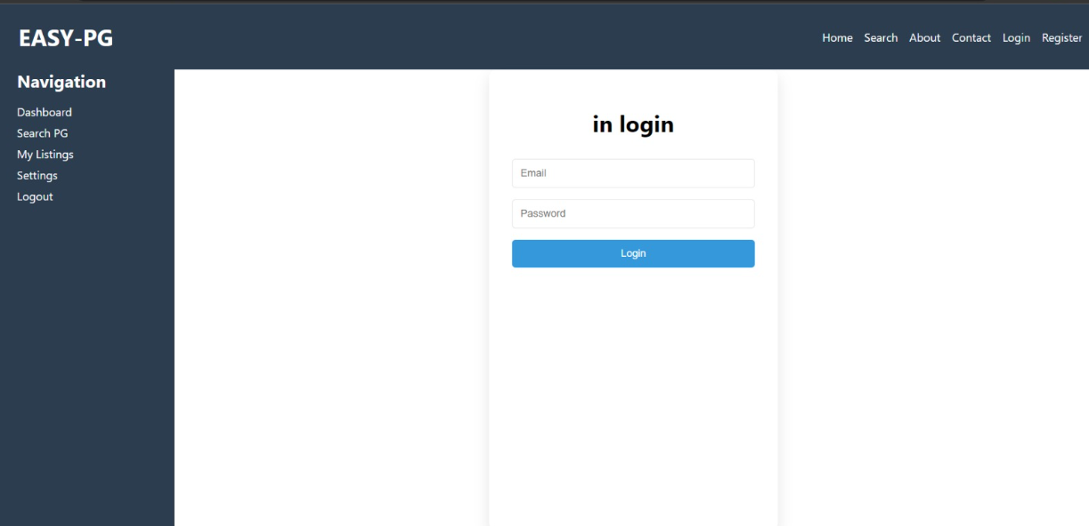

Slide 21
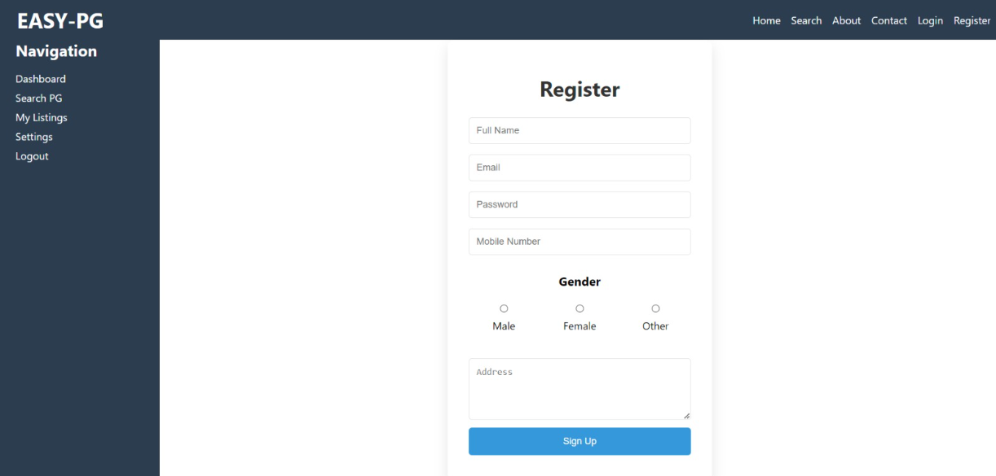

Slide 22
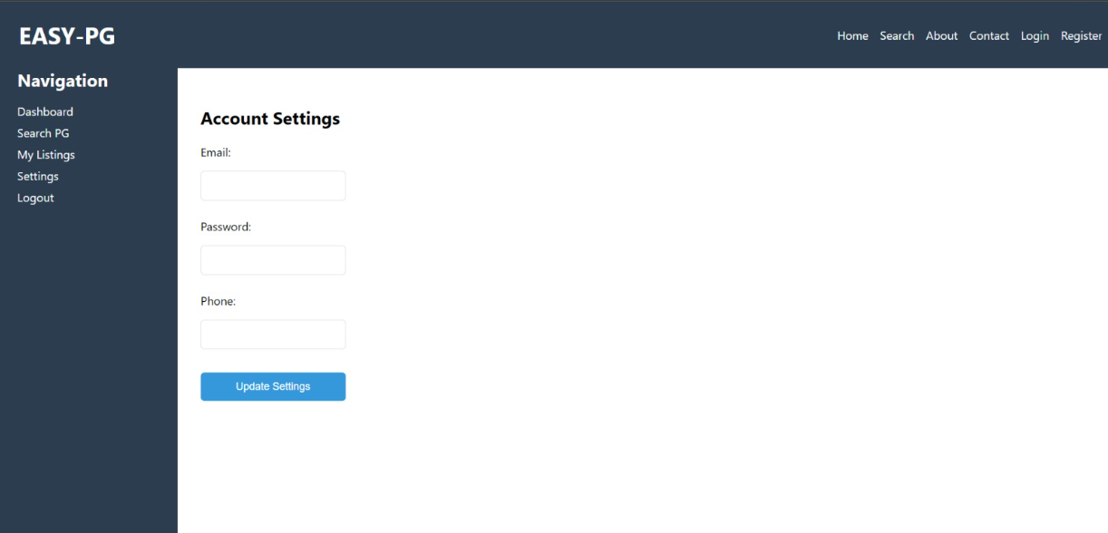

Slide 23
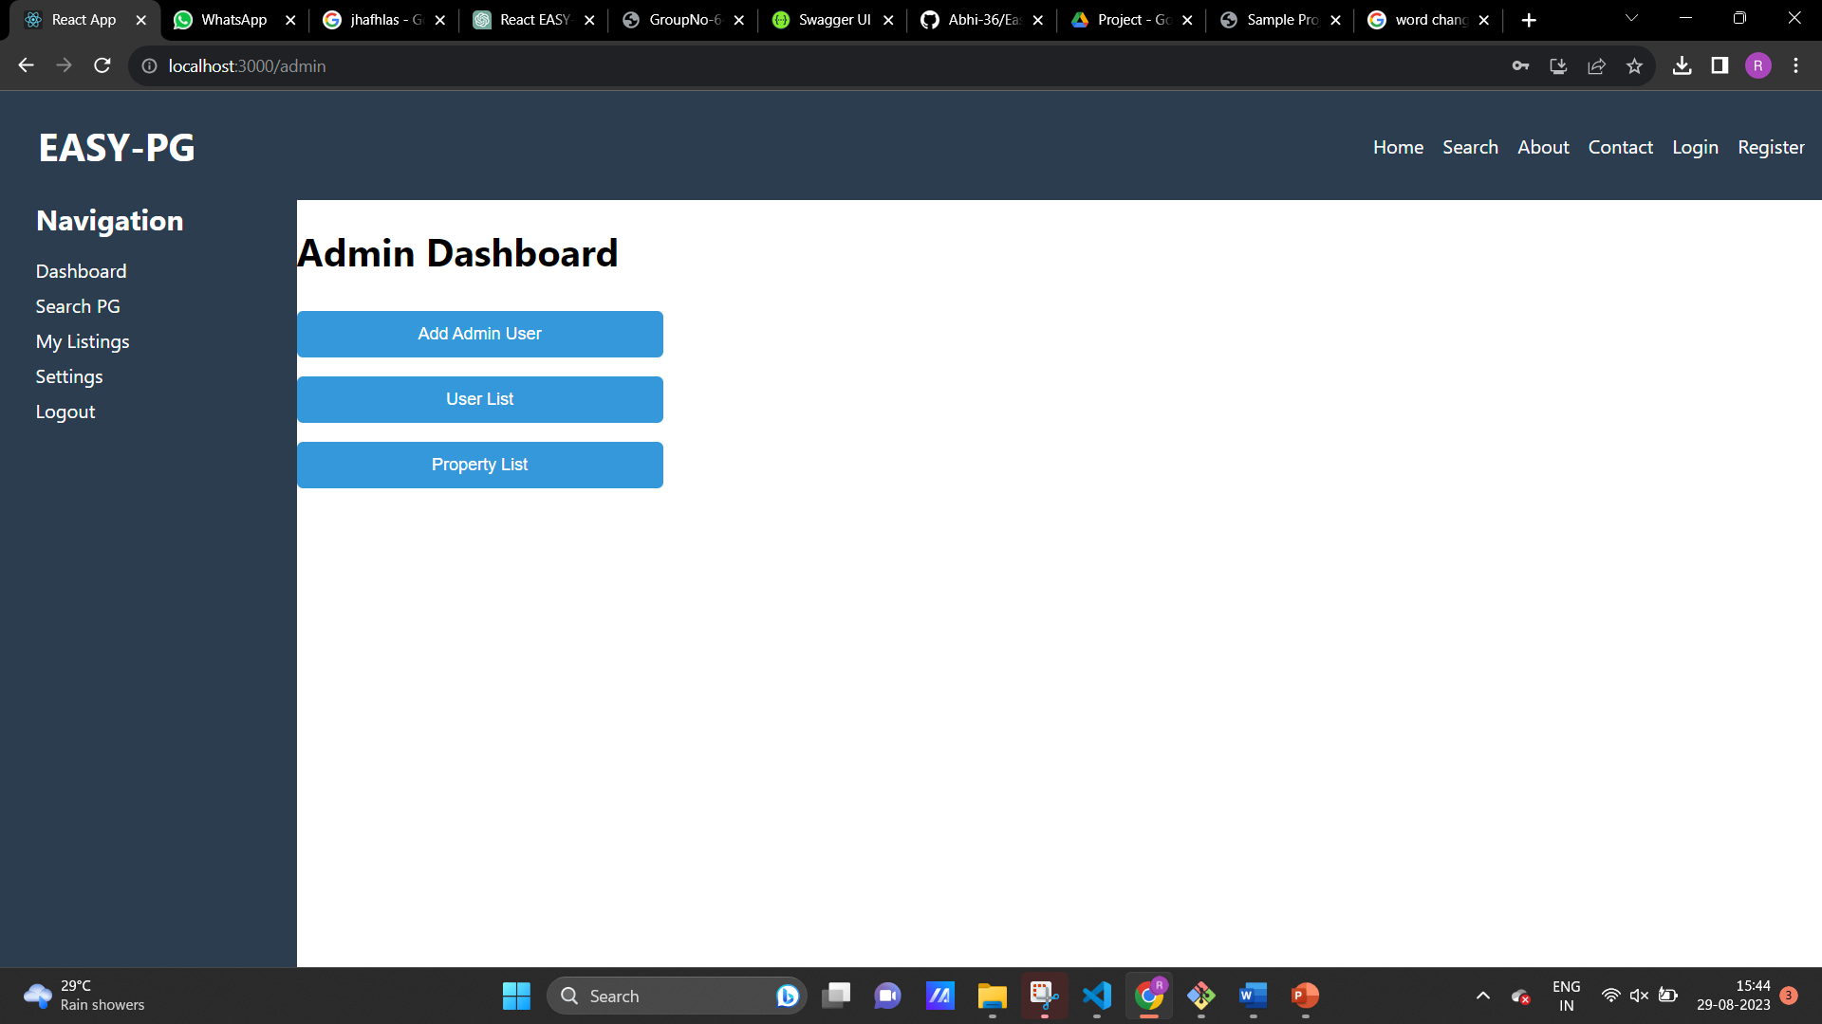

Slide 24
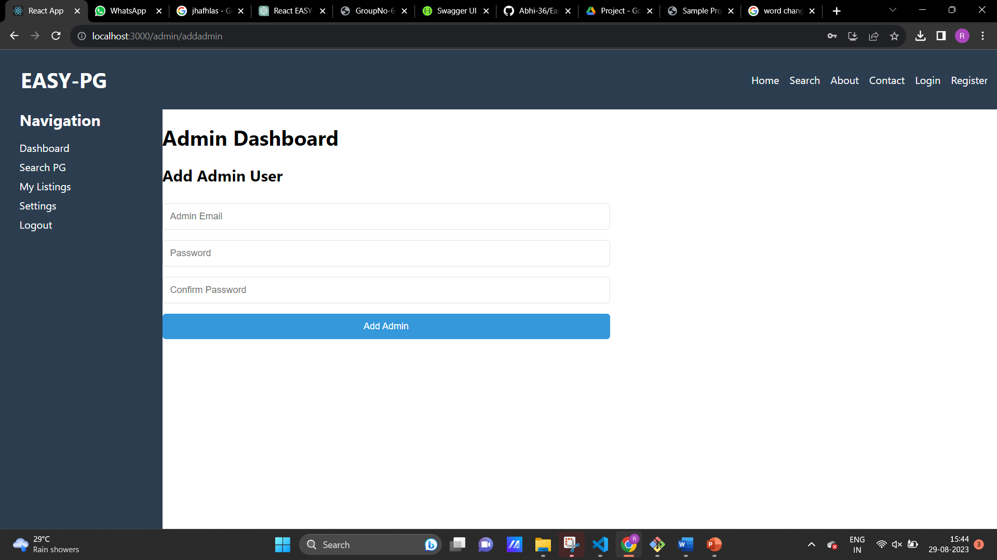

Slide 25
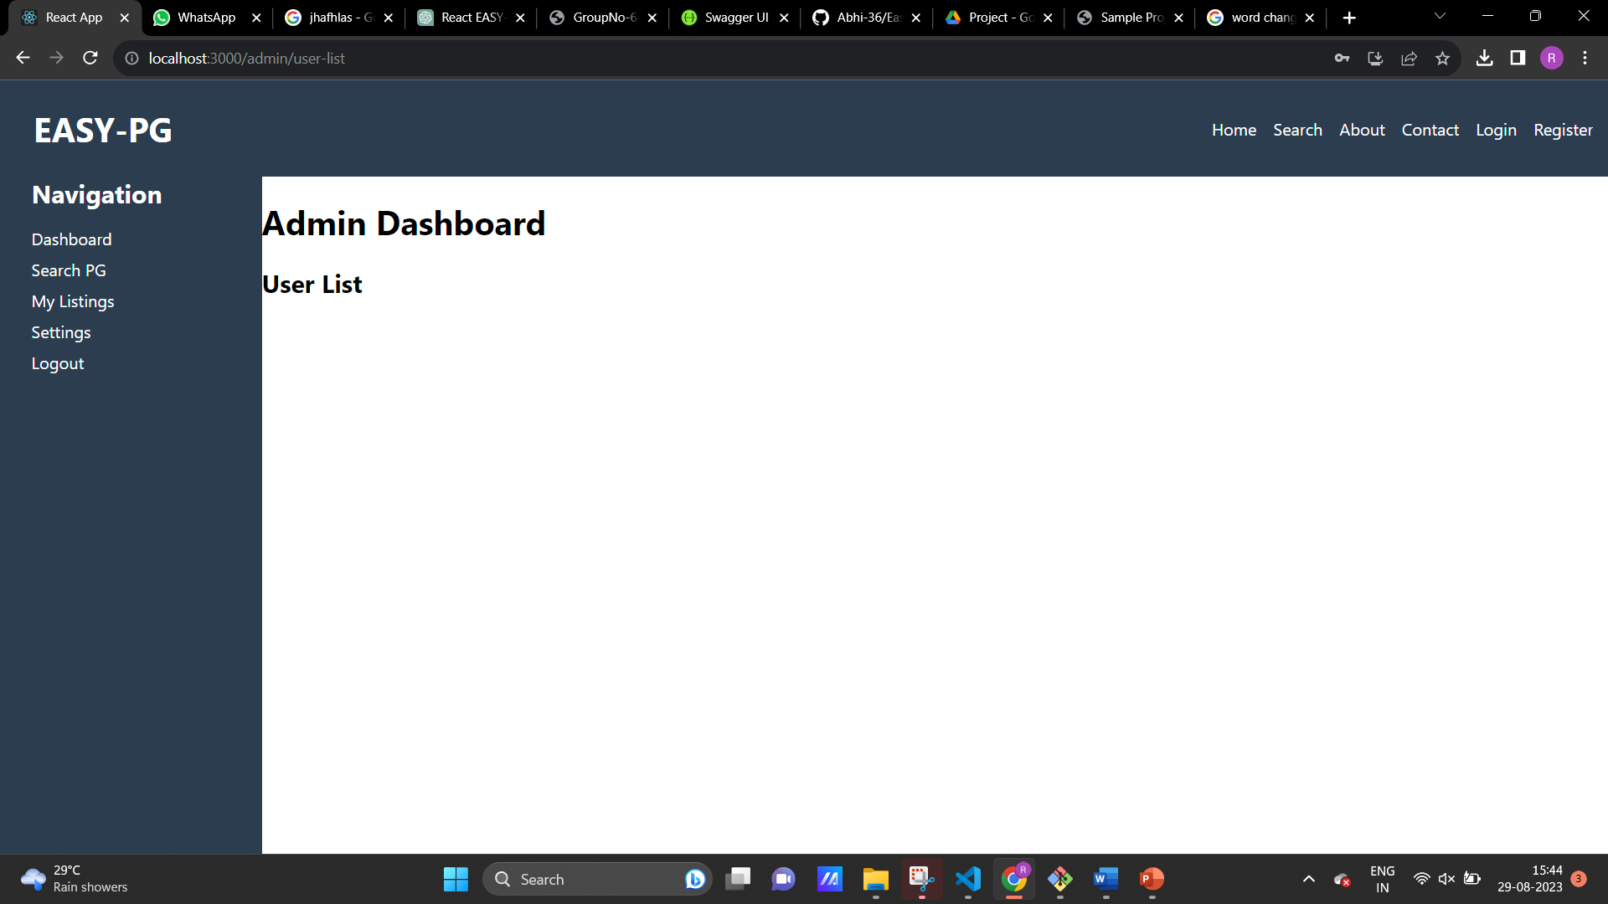

Slide 26


Slide 27
Specifications
The application will use JavaScript, jQuery and CSS as main web technologies.
HTTP protocols are used as communication protocols. Client can access it via HTTP protocol.
SMTP protocol is used for Email communication.
Several types of validations make this web application a secured one.
Since Easy-PG is a web-based application, internet connection must be established.
The Easy-PG will be used on PCs and will function via internet or intranet in any web browser.

Slide 28
Software and hardware requirement
Server Side:
Processor: Intel® Xeon® processor 3500 series
HDD: Minimum 500GB Disk Space
RAM: Minimum 4GB
OS: Windows 10, Linux 6
Database: MySQL
Client Side (minimum requirement):
Processor: Intel Dual Core
HDD: Minimum 80GB Disk Space
RAM: Minimum 2GB
OS: Windows 7, Linux

Slide 29
Conclusion
The Main purpose of developing the “Career Service Portal” is to provide the job to the underprivileged and unorganized sections of the society. Unlikely the Educated as well as privileged people, this section of people do not have a portal which can help them to be informed about day-to-day/Part time/Temporary jobs recruitment according to their Skills.
This Portal will help them thoroughly to get their job easily and efficiently. After registration they can apply to various jobs and will get informed about any government private or NGOs recruitment through in app messages.

Slide 30
Future Scope
Location Wise Filtering
This is the next add on we are currently working on, wherein using Google Maps services we would be connecting buyers and sellers staying in the same or nearby locality, this would the process of renting out. This way we target to mainly saving on travelling time and enhance the process of renting out amongst the users.

Slide 31
Validity Extension :-
When the seller keys in the product details, there is an option stating for how long does he wish to rent out his/her product, the buyer and the seller agrees upon a fixed time and price, sometimes the buyer may like to keep the product a little longer than the time agreed upon, in this scenario we would be adding new functionality of validity extension. Here, the buyer can notify the seller through a text message or an email that he or she would be renting the product a little longer than expected, the renting prices would now be negotiated accordingly.

Slide 32
References
https://www.nobroker.in/
https://www.zillow.com/

Slide 33
Thank you

